Slide 1

SAVE THE W LD
Greg Faletto Javier Orraca Shruhi Desai Sam Park Faizan Haque

Slide 2
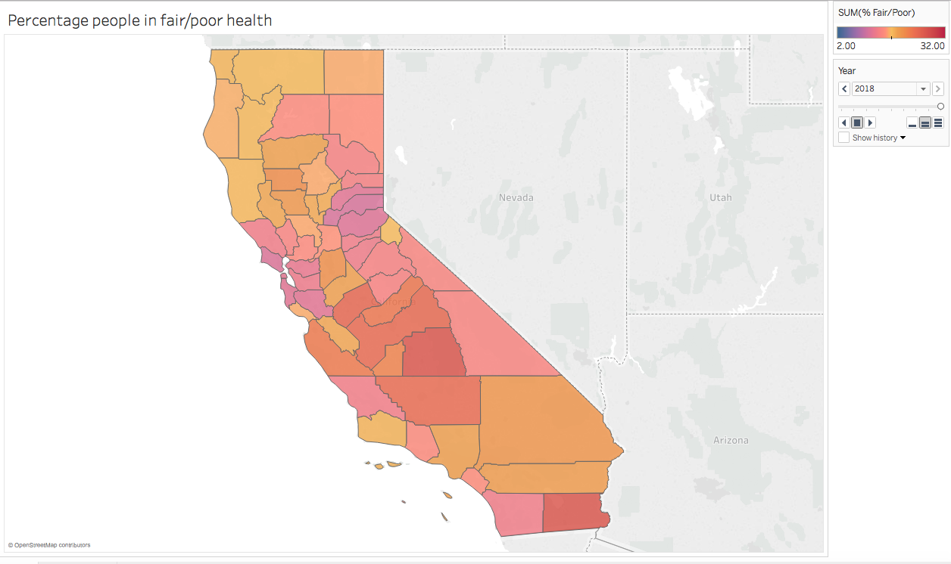
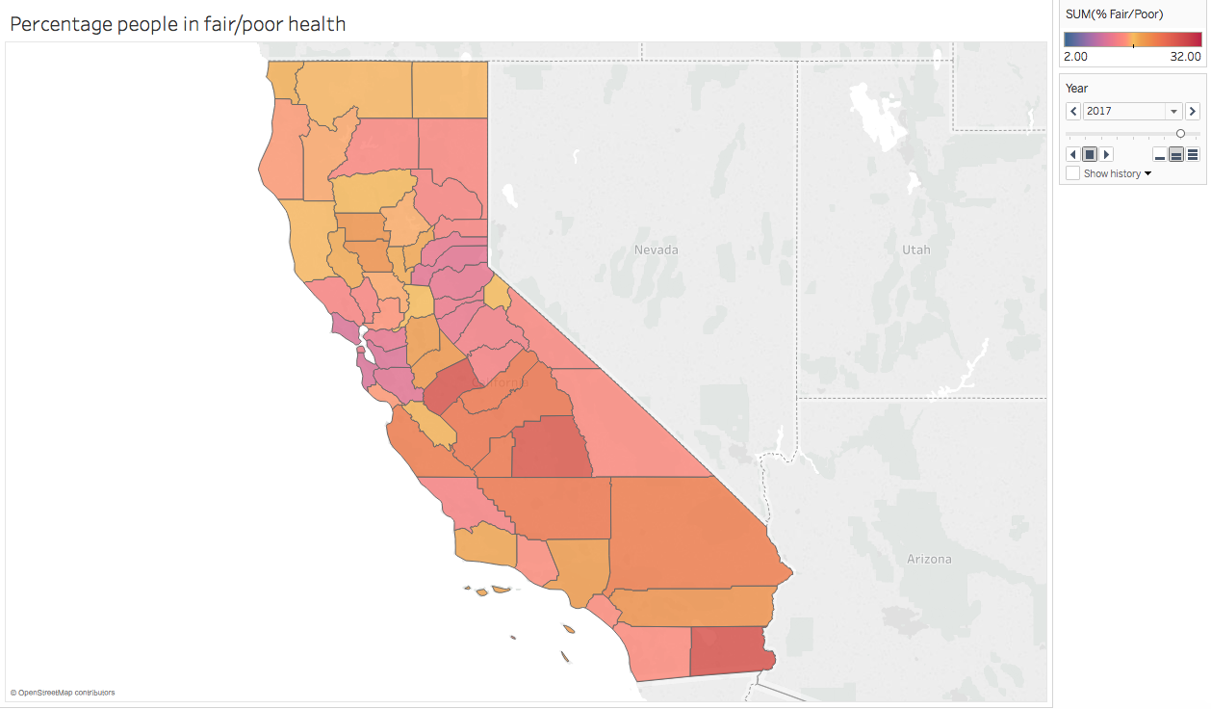
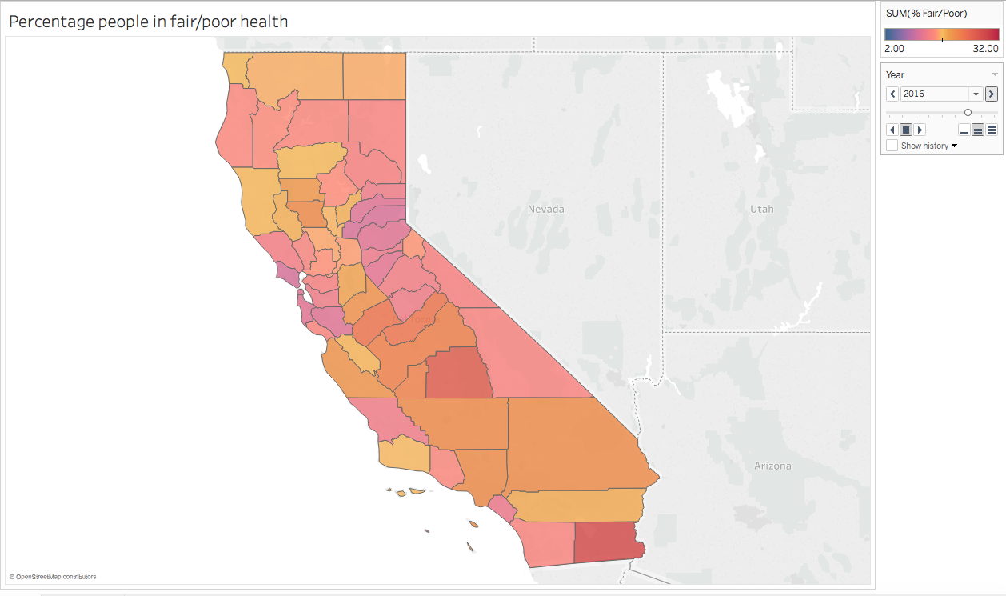
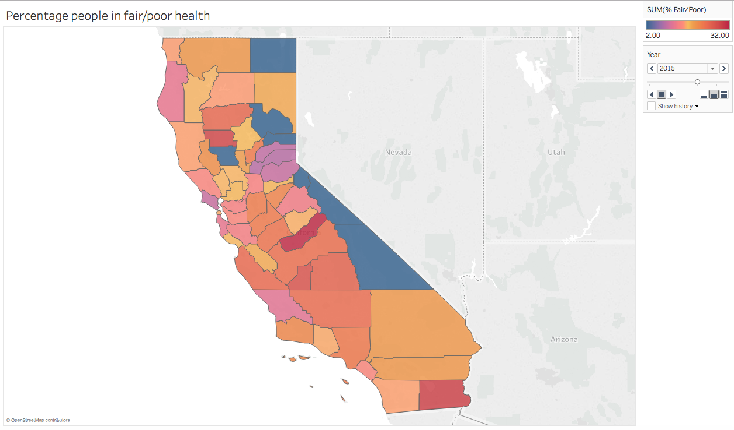
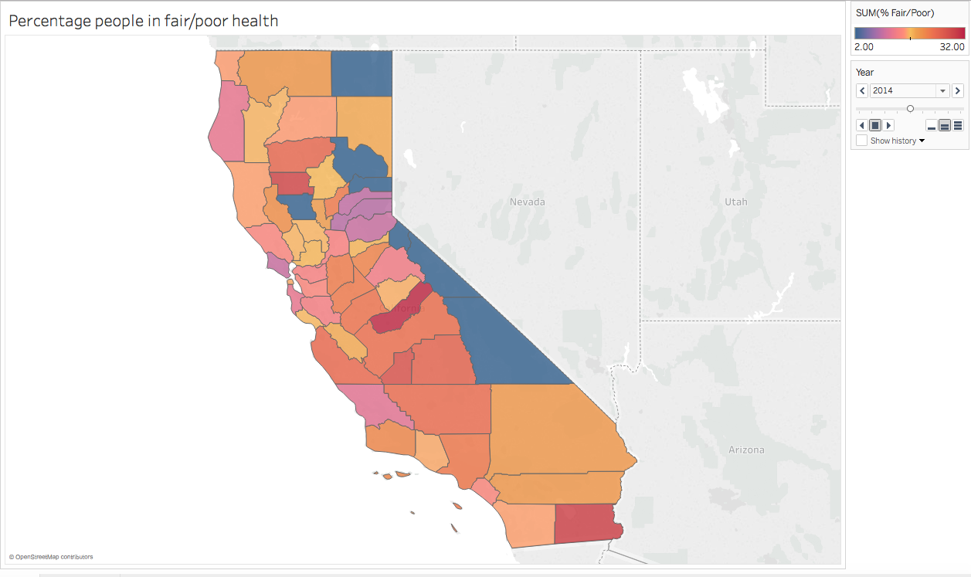
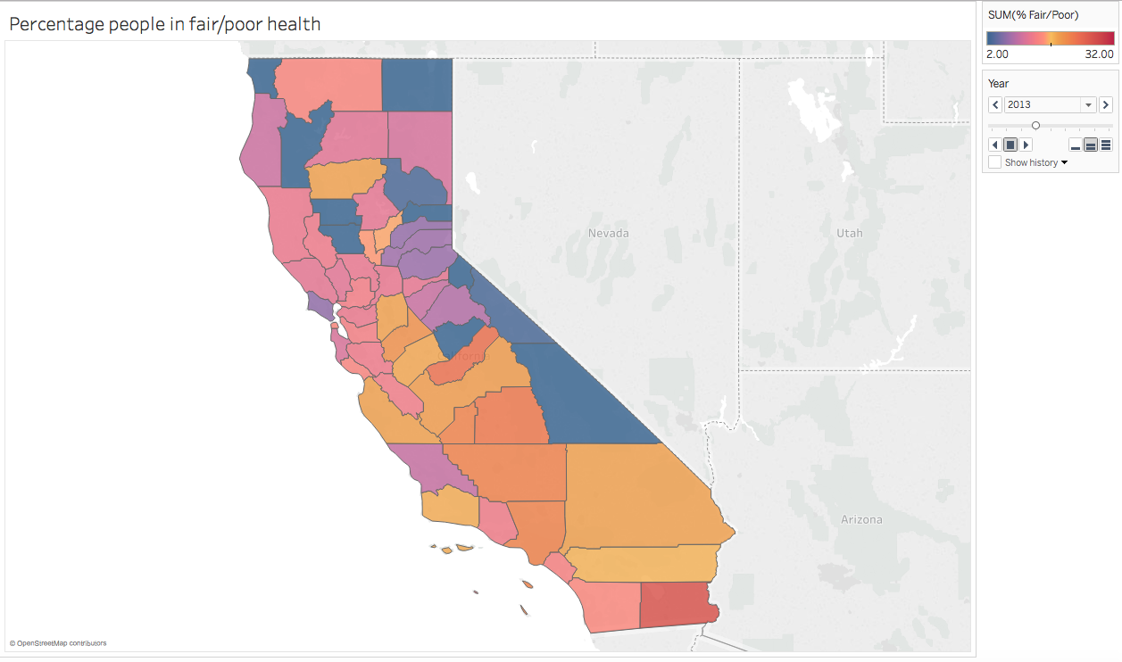
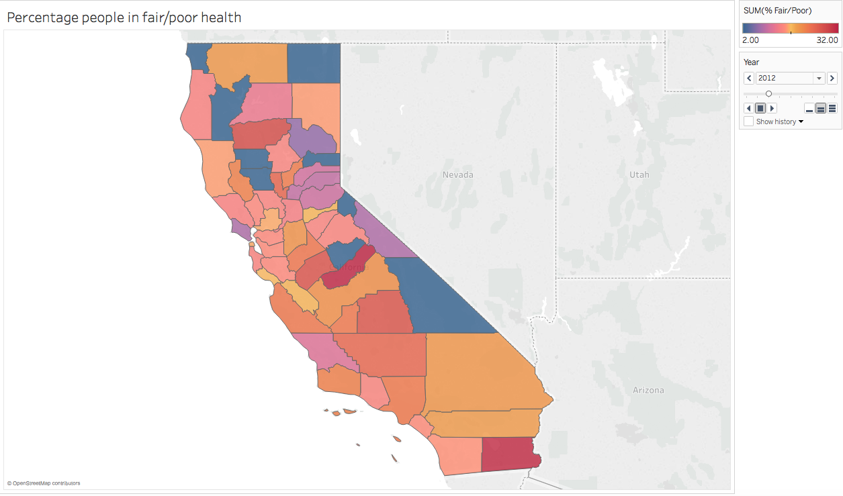
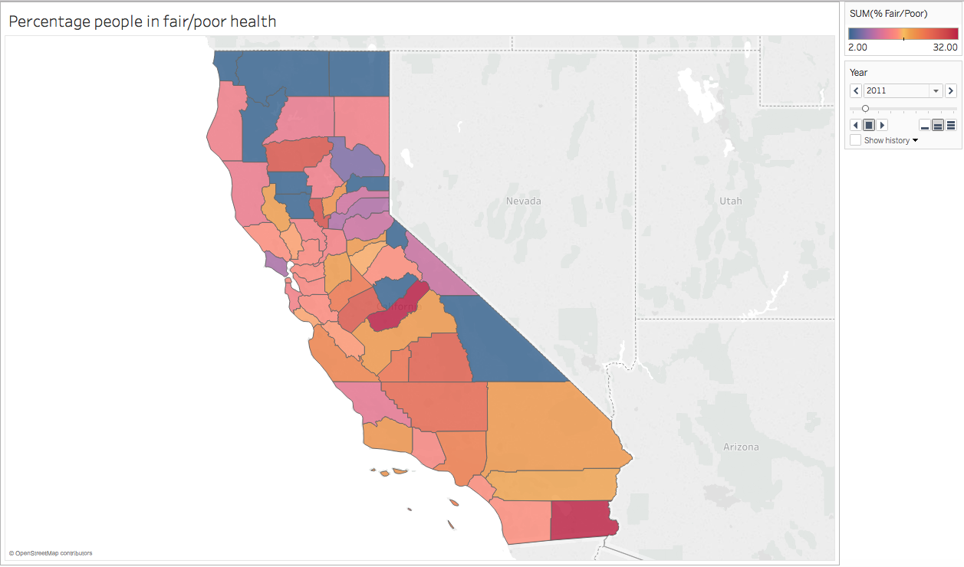
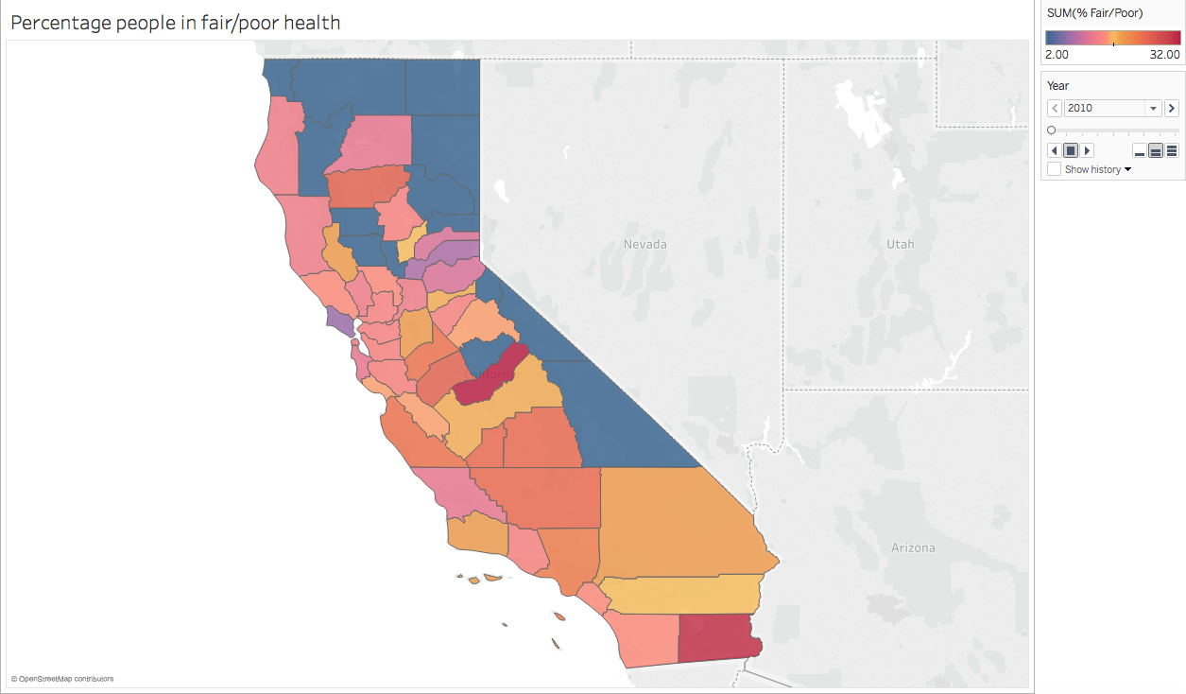
% PEOPLE IN POOR/FAIR HEALTH
FROM
2010-2018

Slide 3
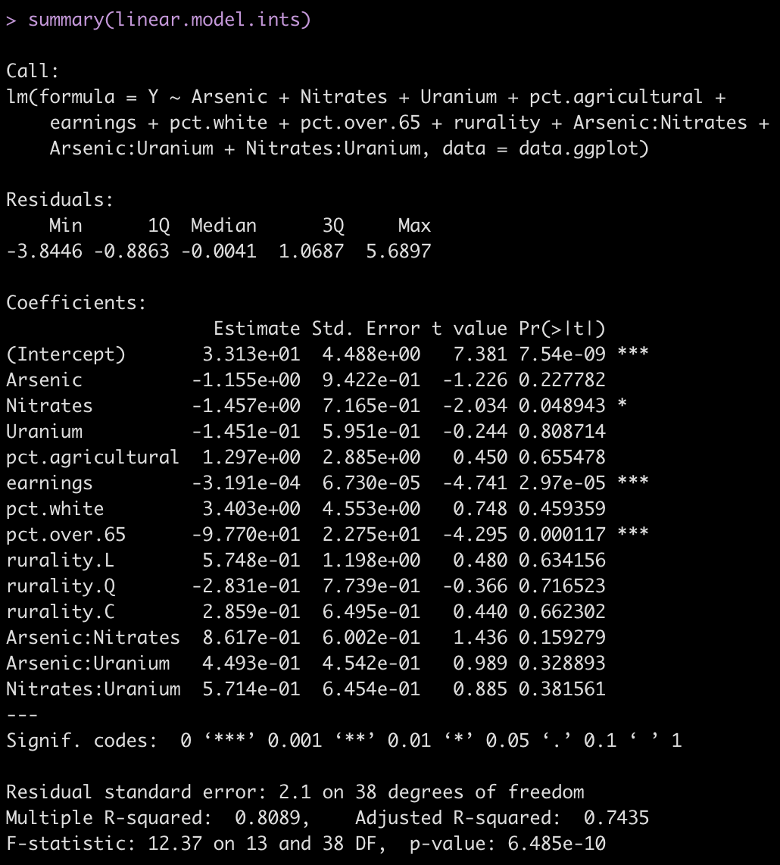
HEALTH IMPACTS
(% PEOPLE IN FAIR OR POOR HEALTH)
CALIFORNIA COUNTY WISE
DEPENDING ON:
Population over 65
Rurality
Earnings
Pollutant levels (uG/L)
% White Population

Slide 4
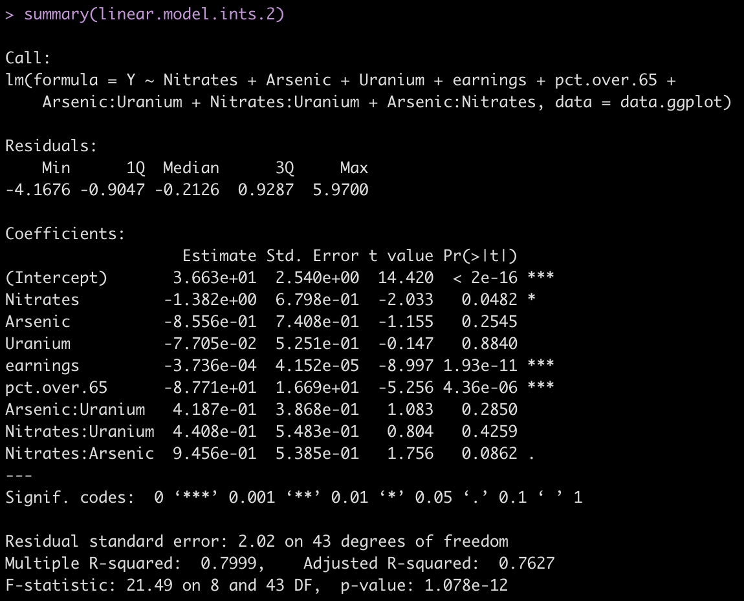
Insights

Slide 5
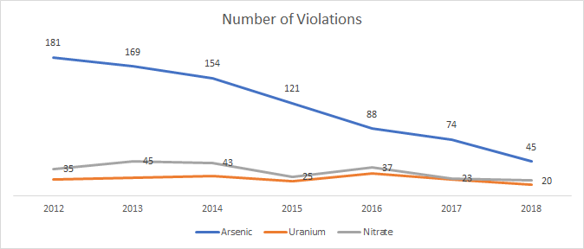
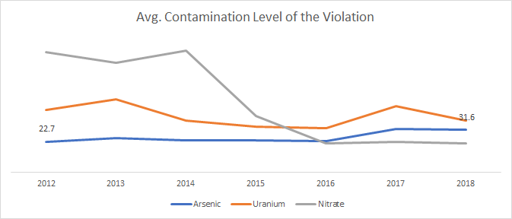
Number of Violations
Due to

Slide 6
Future
Nitrate, Arsenic and other metal tend to affect infants
Research for poisoning effects on gender required

Slide 7
THANKS!
Any questions?

Slide 8
APPENDIX
FOR DETAILS OF OUR PRESENTATION:
https://gregoryfaletto.com/2019/05/19/our-entry-in-the-ocrug-hackathon-2019/
References:
¹ https://www.sciencedirect.com/science/article/pii/S0013935102943380
² Gender and age differences in mixed metal exposure and urinary excretion. https://www.ncbi.nlm.nih.gov/pubmed/21962832
³ Nitrate/Nitrite Toxicity https://www.atsdr.cdc.gov/csem/nitrate_2013/docs/nitrite.pdf

